Slide 1
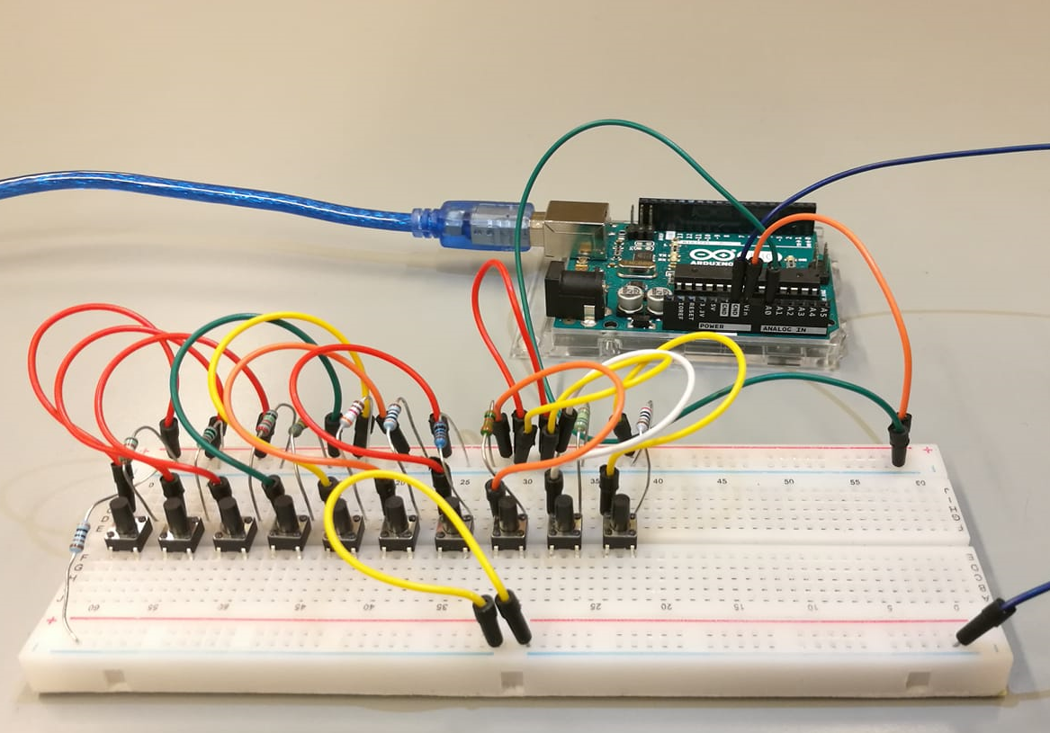
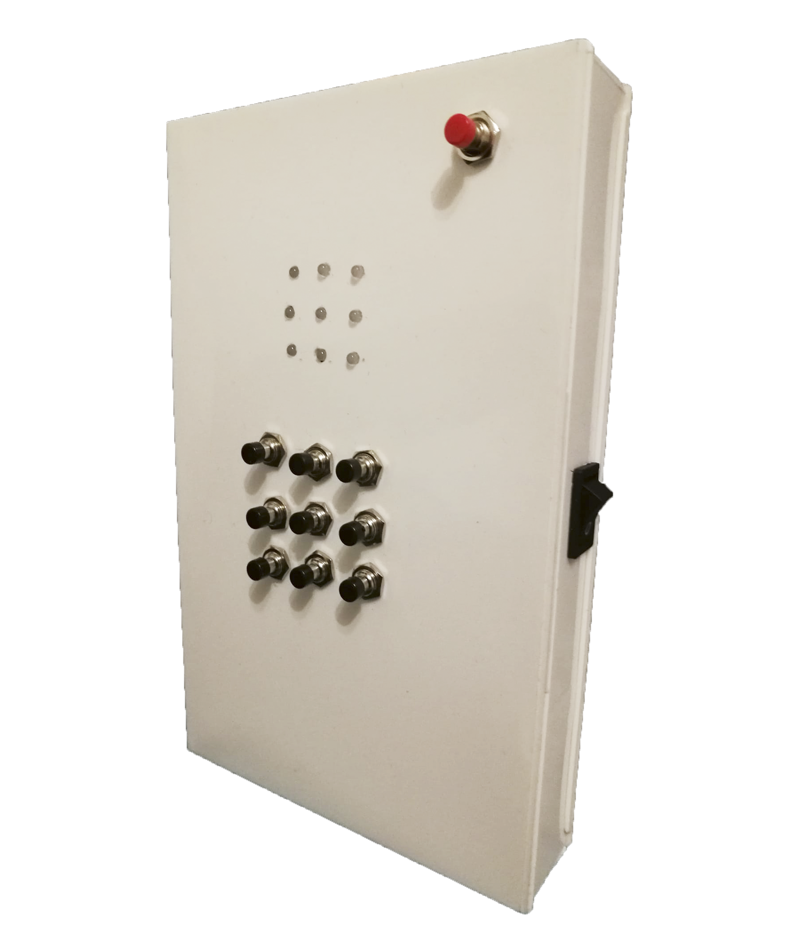
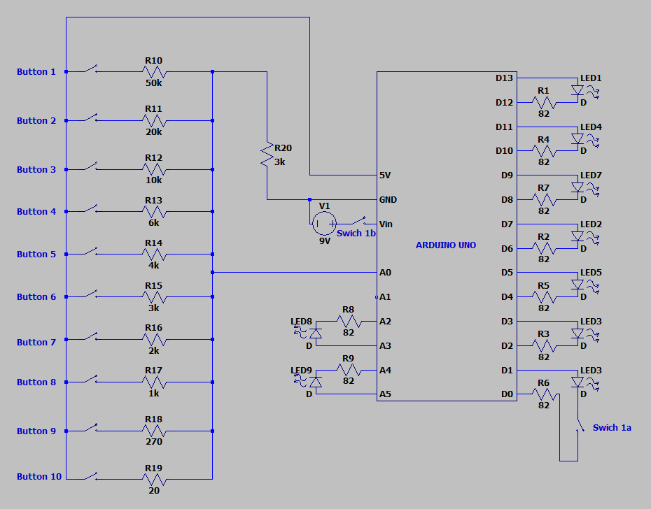
Portable game device
Tapani Silvola, Juha Lallukka, Jesper Ruuska, TVT18SPO
Information Technology, Software Development
Introduction
The aim of this project was to develop a portable game device with three playable games.
Objectives
The basic aims included constructing the game device and developing scripts for the included games that were a memory game, a reaction game and a two player tic-tac-toe game. An additional aim was to develop an interface where player can choose which game to play.
Other possible extensions were to develop an AI for the tic-tac-toe and a tweeter for games sound effects but those were dismissed by schedule.
FIGURE 1. The Circuit diagram
Methods
The device is built around an Arduino Uno board. It contains nine bi-coloured LEDs, ten push buttons, several resistors and a two channel power switch which duplicates as a switch to cut off the LED connected
to serial communication pins during software upload. (See Figure 1 above)
FIGURE 2. The first button circuit prototype coupled with Arduino board
Results
The game device works as intended and the games are selectable by the player.
In the memory game the player must remember a sequence of LEDs blinked by the device and push the buttons in corresponding order. The sequence gets longer as the game proceeds and a failure leads to game over
In the reaction game the device turns a single green LED on and the player must press the analogous button before the LED is turned off. As the game proceeds the time between turning LEDs on and off gets shorter and red LEDs that should be avoided are also introduced.
Pushing the button when a red LED is activated or failing to push the button before green LED is turned off leads to game over.
The last game is an implementation of the classic tic-tac-toe game. Two players keep playing until one player wins by getting three LEDs in a horizontal, vertical, or diagonal row or game ends draw as all LEDs are turned on and neither player won. The device shows wins and draws with LED signals.
FIGURE 3. The Game device
Conclusions
The input system has some issues with reliability as approximately two percent of button pushes are missread. Consequences were althought minimized by strict threshold values and slightly delayed reading of button values. Also using the serial connection pins for controlling a LED had some issues especially during the debugging.
Software Application Project
ECTS credits: 15
Date of publication: 2018, Autumn
Instructors: Jaakko Kaski, Veijo Väisänen

